Slide 1


Sentiment Analysis for
#InfinityWar
Manas Kulkarni • Milind Nandankar • Samadhan Sonwane

Slide 2

Objective
To perform sentiment analysis on the tweets extracted using the hashtag ‘InfinityWar’ and group the results for different targeted geographical regions.

Slide 3
Data Extraction
Initially, NodeXL was used to extract the twitter data. But, it didn’t get us the location information we needed.
So the overall objective was attained using Python libraries:
• Tweepy • TextBlob

Slide 4
1. Authentication
def __init__(self): # keys and tokens from the Twitter Dev Console consumer_key = ‘**********************************' consumer_secret = '*******************************' access_token = '**********************************' access_token_secret = '***************************' # attempt authentication try: # create OAuthHandler object self.auth = OAuthHandler(consumer_key, consumer_secret) # set access token and secret self.auth.set_access_token(access_token, access_token_secret) # create tweepy API object to fetch tweets self.api = tweepy.API(self.auth) except: print("Error: Authentication Failed")
API: We used the twitter stream API to extract data. This API gives live twitter data.

Slide 5
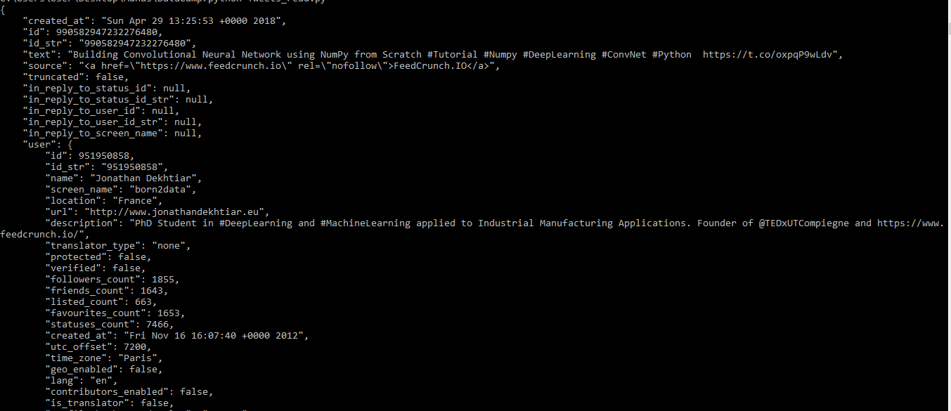
2. Fetching the tweets with Tweepy
All the extracted tweets were in the JSON format.

Slide 6
3. Classifying the sentiment with TextBlob
def clean_tweet(self, tweet): ''' Utility function to clean tweet text by removing links, special characters using simple regex statements. ''' return ' '.join(re.sub("(@[A-Za-z0-9]+)|([^0-9A-Za-z \t])|(\w+:\/\/\S+)", " ", tweet).split()) def get_tweet_sentiment(self, tweet): ''' Utility function to classify sentiment of passed tweet using textblob's sentiment method ''' # create TextBlob object of the passed tweet text analysis = TextBlob(self.clean_tweet(tweet)) # set sentiment if analysis.sentiment.polarity > 0: return 'positive' elif analysis.sentiment.polarity == 0: return 'neutral' else: return 'negative'
TextBlob assigns a polarity based on the words in a tweet. The polarity ranges between -1 and 1.
polarity > 0: positive polarity = 0: neutral polarity < 0: negative

Slide 7
Challenges
1. Simple vs Complex tweets
Simple tweet: ‘This is the best movie ever’
Complex tweet: ‘I'd really love going out in this weather!’ (Possibly sarcastic) and, tweets which need negation handling

Slide 8

Challenges
2. API limitations
With Tweepy we could extract only 2000 tweets per API call. An error is received if more number of tweets are requested:
We had to wait for 15 minutes to trigger the next API call.

Slide 9
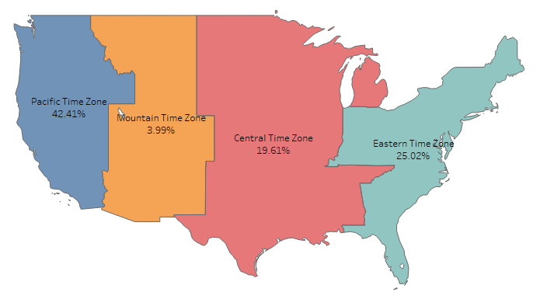
Tweets from Different Time Zones

Slide 10
Overall Sentiment

Slide 11
Eastern

Slide 12
Central

Slide 13
Mountain

Slide 14
Pacific

Slide 15
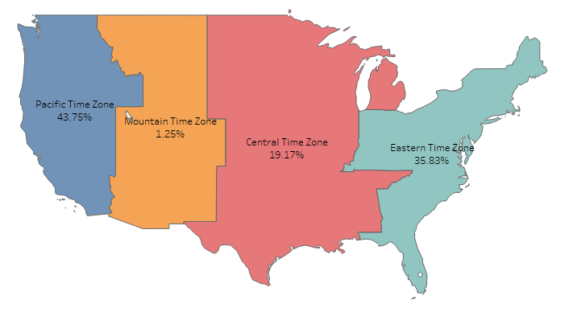
Negative Sentiments

Slide 16
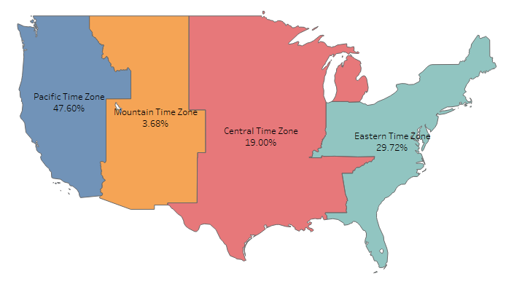
Positive Sentiments

